Slide 1

Medicare D Monthly Huddle: March 2025
Caremark Member Operations
©2024 CVS Health and/or one of its affiliates. Confidential and proprietary.

Slide 2
Agenda
Key Habits for Improving NPS & Member Experiences Audience: All Med D Colleagues (CVS and Vendor Colleagues)
CAHPS Surveys Audience: All Med D Colleagues (CVS and Vendor Colleagues)
Alternate Formats and/or Non-English Languages Audience: All Med D Colleagues (CVS and Vendor Colleagues)
Transition Fill Reminders
Audience: All Med D Colleagues (CVS and Vendor Colleagues)
Verbal Late Enrollment Penalty (LEP) Attestations Audience: All Med D Colleagues (CVS and Vendor Colleagues)

Slide 3
Agenda
MetroPlus Reminders
Audience: All MetroPlus Colleagues (CVS and Vendor Colleagues)
Elderplan Reminders
Audience: All Elderplan Colleagues (CVS and Vendor Colleagues)
Clover Health Reminders
Audience: Clover Health Colleagues (CVS and Vendor Colleagues)
Kudos
Audience: All Med D Colleagues (CVS and Vendor Colleagues)

Slide 4

Caremark Member Operations
3 Key Priorities
Deliver an exceptional member experience on every interaction.
Eliminate waste in our processes and create efficiencies where possible.
Develop high-performing colleagues and teams.

Slide 5
Key Habits for Improving NPS & Member Experiences Audience: All Med D Colleagues (CVS and Vendor Colleagues)

Slide 6





Key Habits for Improving NPS & Member Experiences
Confidence & Assurance
Avoid Running Out
Establish Trust
First Call Resolution
Say “Yes, I can help you with…”
Ask “Do you have at least 5 days of meds remaining?” when a member is inquiring about their medication
Provide accurate education & next step expectations by using your work instructions or CIF on every call.
Recap the call and secure member confirmation.
Notes:
These four key habits are simple actions that result in moving people by creating positive emotions and starting conversations.
Saying “Yes, I can help you with…” creates immediate member confidence, assurance and puts them at ease that we’re going to take care of them.
Asking days on hand is how we can make sure they don’t run out of medication. It’s looking out for unspoken needs.
Using resources establishes, grows and strengthens trust because we’re providing consistent and correct information every time.
Recapping the call is how we make sure everything the member needed was taken care of the first time.
Say: For you, when you consistently do these, it’ll help to improve your:
WECare and NPS metrics.
Call control abilities.
Overall confidence.
Mental health tied to having improved member conversations.
Do: lookout for what goes here

Slide 7
4 Key Habits for Better Member Experience
Call studies and pilot programs conducted by CVS Caremark have demonstrated a strong correlation with member experience and consistently following the 4 Key Habits:
Provide a ‘yes I can’ statement/reassurance statement.
When we respond to the reason for the call with a definitive support statement, we take control of the call and put the agent in the driver’s seat.
By responding to the member with a statement such as, “I can absolutely help you with your order today,” we reassure the member we heard them, and we can help. This quickly forms the beginning of trust and leads the caller to allow the agent to begin to assist them.
Ask Days’ Supply of the medication the member has on hand.
This reassures the member we are actively working to ensure all their needs are met, not just completing the order, but that we are looking out for their best interests.
Asking this question also allows us to resolve potential concerns quickly and proactively, and to reduce callbacks.
Access and appropriate utilize CIF/Work Instructions.
By properly utilizing the CIF/Work Instructions we ensure that we are following the proper processes and procedures for members of each plan.
The CIF allows us to determine what modifications (if any) from the typical process (as outlined in the WIs) should be taken to support members on this plan. By referring to the appropriate Work Instructions on every call, we ensure no steps are missed and can confidently respond to any member questions/concerns.
Even if agents believe they are confident in a process (such as a standard refill), when we utilize the Work Instruction as a checklist, we ensure every step is followed, the member is fully educated/advised on next steps, and the call can be resolved fully with true assurance.
Summarize/recap reason for call, including ensuring all concerns have been addressed.
Recapping the call, in plain language, reassures the member of the steps we have taken to fully resolve their needs, and close any gaps.
By including any next steps (either we will take, or the member should take), we ensure the member has a clear understanding of the process and reasonable expectations are set. Restate any turn around times provided to ensure member comprehension.
By asking the member to confirm their needs have been resolved, we close the call with the caller having confidence in us and how we are supporting them.

Slide 8
4 Key Habits for Better Member Experience
Don’t forget to Secure Member Confirmation within your recap.
In the below examples, Blue text is the review portion of the recap, red is how we can secure confirmation:
“I have started the order for you for your 3 medications today. They will ship in 1-2 business days, and after they have shipped you can absolutely track them on Caremark.com using that registration link we sent you today. Have I fully resolved the reason for your call today?”
“Today you called in regarding the rejected claim for Wegovy through the local CVS Pharmacy. We discussed the medication requires a prior authorization to be covered & I submitted an EPA form to the doctor’s office for that. I advised once the form is received from the doctor’s office it would take 24-72 hours to be completed. You have enough medication on hand until the decision is made on the prior authorization. Did I cover all of your reasons for contacting us today?”
Again, by asking the member to confirm their needs have been resolved, we close the call with the caller having confidence in us and how we are supporting them. Do you understand the purpose of the recap? Let’s Practice!

Slide 9
CAHPS Surveys Audience: All Med D Colleagues (CVS and Vendor Colleagues)

Slide 10
CAHPS Surveys
Consumer Assessment of Healthcare Providers and Systems (CAHPS) Surveys will begin to be sent to beneficiaries in March 2024.
CCRs can provide excellent member experience to drive positive CAHPS survey results.
CAHPS Surveys are questionnaires sent out by CMS to plan members assessing their health care experience.
Excellence in this area relies heavily on complete and accurate verbal and written communication, treating all beneficiaries with courtesy and respect, and ensuring beneficiary needs are fully resolved prior to disconnecting.
Each time a CCR interacts with a beneficiary, verbally or through written communication, CCRs can improve the member’s experience and positively impact our performance on CAHPS Survey results.
For additional information, refer to Content ID : CMS-PRD1-109202 MED D - CAHPS Surveys

Slide 11
Alternate Formats and/or Non-English Languages Audience: All Med D Colleagues (CVS and Vendor Colleagues)

Slide 12
Alternate Formats and/or Non-English Languages
Beneficiaries may request plan materials in an accessible format and/or non-English language.
All requests will be submitted using the appropriate Account Consideration Task.
The following work instructions have been updated to reflect the new process.
TSRC-PROD-061924 Compass MED D - Member Resource Orders (Fulfillment Request)
TSRC-PROD-061526 Compass MED D - Explanation of Benefits (EOB)
TSRC-PROD-061779 Compass MED D - Medicare D Explanation of Benefits (EOB) Preferences
TSRC-PROD-061763 Compass MED D - Viewing Correspondence and Requesting Reprints
Exception:
For Premium Billing Invoices, continue to refer to:
Aetna Compass MED D - EGWP & SilverScript - Premium Billing Invoice Requests
Compass MED D - Blue MedicareRx (NEJE) - Premium Billing Invoice Requests

Slide 13
Transition Fill Reminders Audience: All Med D Colleagues (CVS and Vendor Colleagues)

Slide 14
Transition Fill Overrides
Customer Care should not enter a Transition Fill Override.
Refer to the CIF for client specific directives or exceptions.
Transition Fills are not allowed for the following rejects or medications:
· CMS Drug exclusions
· Safety Edits
· Diagnosis required for D coverage drugs
· B vs D coverage requirements
· Age or Gender Edits

Slide 15
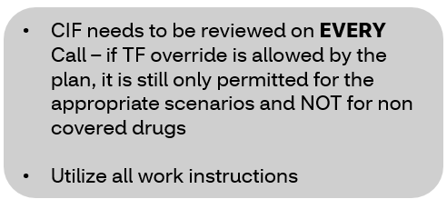
Medicare D - Transition Fill Overrides
1.ONLY permitted for Nursing Home and LTC (Long Term Care) transitions
2. Should NEVER be used for drugs that are not covered
RTS(refill too soon) is the only appropriate reject for this override
TF excluded drugs are any drug that reject 75 or 70
3.Should NEVER be used during the plan transition period; first 90 days of a new implementation
ALL drugs that are eligible for transition fills during this time will be coded in the benefit and DO NOT require an override.
Professionalism/Empathy: Each caller is a person with their own worries, fears, and stress factors. Every caller may be dealing with a range of situations, and it is the representative’s job to acknowledge the member and treat each person professionally, with respect and empathy.
Acknowledge: Show empathy to the caller with frustration.
Probe: Ask questions.
Prevention: Educate the caller.
Content ID : TSRC-PROD-061926 Compass MED D - Transition Fill Care Processes

Slide 16
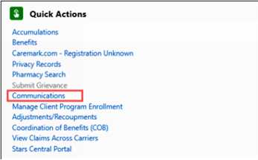
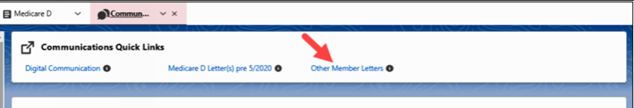
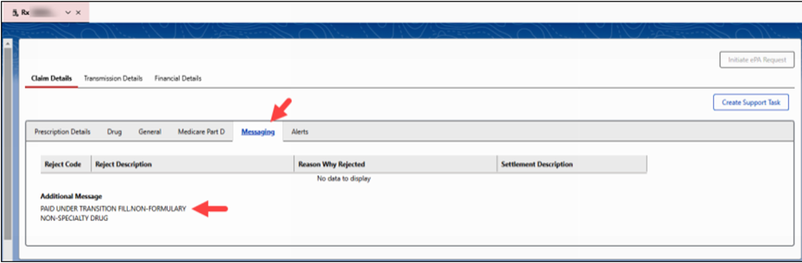
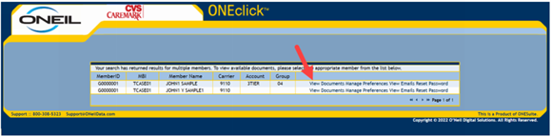
Transition Fill Care Process
A transition fill for up to at least 30 days will be allowed for existing beneficiaries, during the first 90 days of the new benefit plan year.
•First fill of the year, the claim will not be rejected when processed for 30 days.
•Member and doctor will be sent letter within three business days.
•Claims detail screen will show paid under transition fill.
Accessing ONEclick Letters:
From the Member Snapshot Landing Page, navigate to the Quick Actions panel and click Communications.
Other member letters
View Document and drop down to view the appropriate document.

Slide 17
Verbal Late Enrollment Penalty (LEP) Attestations Audience: All Med D Colleagues (CVS and Vendor Colleagues)

Slide 18
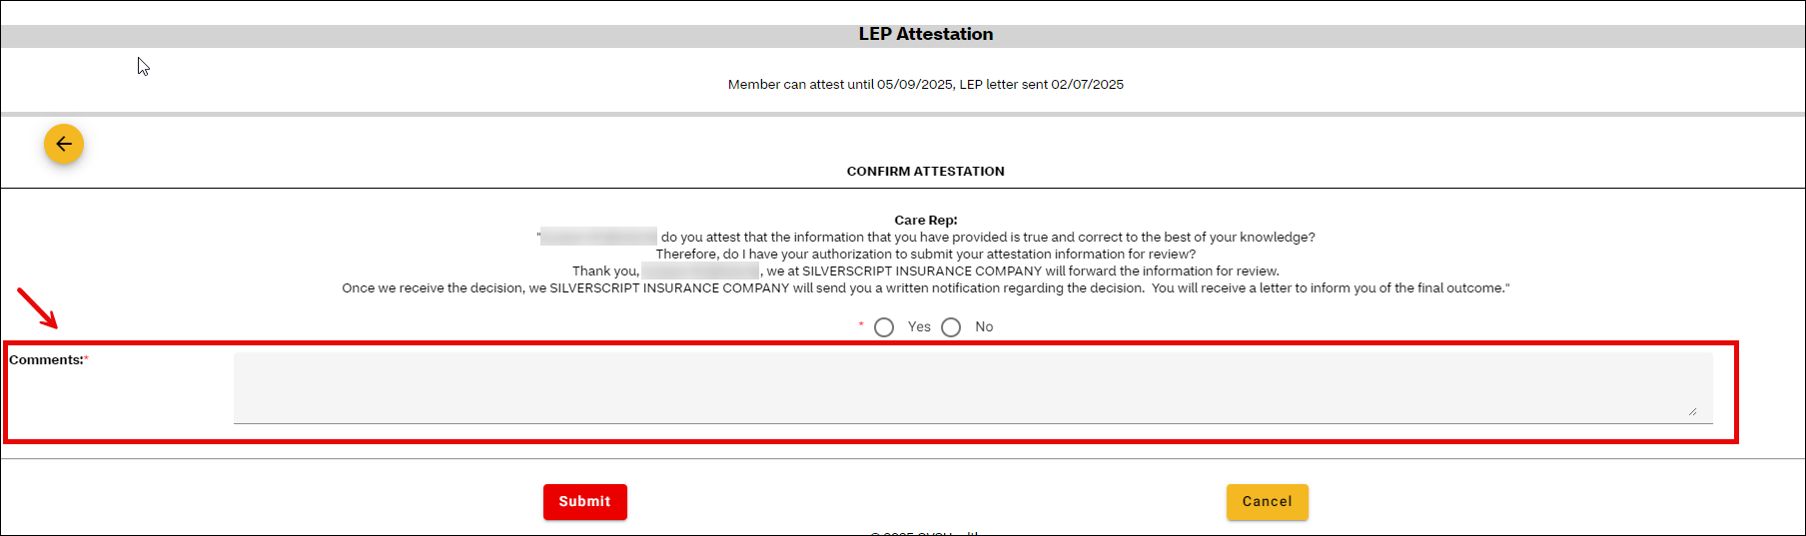
Verbal Late Enrollment Penalty (LEP) Attestations
Description: The Med D process for obtaining verbal LEP attestations is being updated so that prior insurance information or prior employer information will be collected from beneficiaries.
The CCR MUST obtain the prior insurance company and/or the name of the prior employer.
System enhancements will be implemented for this update. In the interim, follow the process below to document this information in RxEnroll Care:
The name of the insurance company or employer MUST be entered in the Comments field.
Refer to Compass MED D - Late Enrollment Penalty (LEP) Attestation and Appeals for more information

Slide 19
MetroPlus General Reminders Audience: All MetroPlus (CVS and Vendor Colleagues)

Slide 20

MetroPlus Reminders (carrier: x8541)
Groups: MAAD01, MAAD02, MAAD03, MAAD04, MAAD1R, MAAD2R, MAAD3R, OR MAAD4R
Medicaid/Qualified Medicare Beneficiaries (QMB)
Advise members that they must present their Medicaid ID card at the pharmacy for NYRx (NYS Medicaid Pharmacy Program) Medicaid to pay for their Part B cost share; e.g. diabetic test strips.
For pharmacy claim processing issues with the member's NYS Medicaid, the pharmacy can get assistance by calling: eMedNY 1-800-343-9000.
Federal law prohibits pharmacies from billing beneficiaries in the QMB (Part B) program for Medicare cost sharing.
Members are eligible to receive over the counter (OTC) medications and diabetic test supplies, including test strips for $0, however the pharmacy must bill NYRx secondary. WITHOUT billing NYRx the OTC products will not be covered, and diabetic testing supplies will have a 20% coinsurance.
If members have questions regarding the Medicaid NYRx Program they may contact the Medicaid Helpline: at 1-855-648-1909. TTY 1-800-662-1220 Monday - Friday, 8 am – 8pm and Saturday, 9am – 1 pm EST

Slide 21
MetroPlus Reminders Continued…
Vacation Override verbiage has been updated to reflect the following:
Member is allowed 2 yearly Vacation Overrides per drug (maximum 90 day supply per drug)
Controlled Substances and Diabetic testing supplies (test strips, syringes, etc.) are not allowed from this override type. For any requests outside of the process outlined above, please reach out to the Senior team and the Senior should follow their internal process to send request to Client Support.
Diabetic Products
If the diabetic product is not processing at the pharmacy with a $0 member copay, verify that the pharmacy is billing as follows:
MetroPlus Medicare as Primary (which is the member's Medicare Part B Coverage)
New York State Medicaid as secondary.
If the pharmacy continues to receive rejections from New York State Medicaid to cover the member's coinsurance, advise the pharmacy to contact NYS Medicaid pharmacy services to assist with the secondary claim.
Part B Continuous glucose monitoring machine and supplies:
i.e. DEXCOM and FREESTYLE LIBRE are NO LONGER covered at the pharmacy but may be covered via medical benefit.
The provider must fax the request to Integra Partners: 212-908-5185 or call 866-679-1647 to initiate the request via the telephone.

Slide 22
MetroPlus Reminders Continued…
21BM Diabetic Supplies – secondary carrier under Carrier 8541
It is a wrap plan that covers coinsurance for diabetic supplies covered by MetroPlus.
Overrides should not be placed in the 21BM group.
21BM is secondary and 8541 is primary.
Detailed CAG and diabetic supply information is in the MetroPlus Med D CIF under the "Diabetic Supply Benefits" section.
TSRC-PROD-004260 MetroPlus Health Plan Med D

Slide 23
Elderplan General Reminders Audience: All Elderplan (CVS and Vendor Colleagues)

Slide 24

Elderplan Reminders (carrier: x8585, x6417 for diabetic supplies only)
Here are some friendly reminders when managing calls with Elderplan members:
Warm transfers to Elderplan: any calls related to Continuous Glucose Monitor, OTCs, and grievances should be warm transferred back to the plan: Hours of Operation for Elderplan Member Services are as follows: 7 days a week - 8AM-8PM EST/7AM-7PM CST/6AM-6PM MST/5AM-5PM PST. Phone# 800-353-3765
Diabetic Supplies: Carrier 6417 is a diabetic supply carrier only and Care representatives should only discuss information on the 6417 CIF. If a member has both carriers (8585 and 6417), members have to obtain their diabetic supplies under carrier 8585 and not 6417. Please do a thorough check in Compass by searching for first/last name and DOB to determine whether member has both carriers. If member only has 6417 and they are inquiring about non-diabetic supplies, please warm transfer the member to Elderplan: Hours of Operation for Elderplan Member Services are as follows: 7 days a week - 8AM-8PM EST/7AM-7PM CST/6AM-6PM MST/5AM-5PM PST. Phone# 800-353-3765.
M3P: Please check member's LIS status before offering M3P as an option to the member. If a member has LIS, then the M3P program may not be of advantage to the member.

Slide 25
Clover Health General Reminders Audience: All Clover Health (CVS and Vendor Colleagues)

Slide 26
Clover Health Reminders
Clover Health has come across times where we are offering only offering out the Medicare Prescription Payment plan as a viable option to assist our members with drug pricing
We want to also make sure that we are offering out all available options to the Clover Health Members when they mention concerns about not making payments. Some of those options include:
SPAP (EPIC, PAAD, ConnPACE, MA Prescription Advantage, etc.)
Tiering Exceptions
LIS/Extra Help
Clover Health has also moved to Single Sign-on with information in their CIF please review the Client Specific Processes and Web support information sections of the CIF:
CMS-PRD1-071938 Clover Health Advantage PPO (formerly CarePoint)

Slide 27
Kudos Audience: All Med D Colleagues (CVS and Vendor Colleagues)

Slide 28
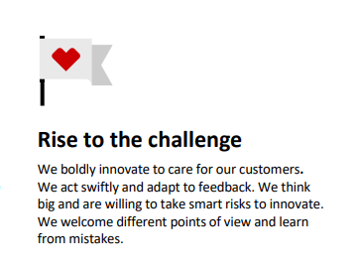
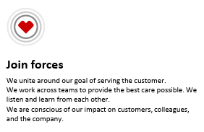
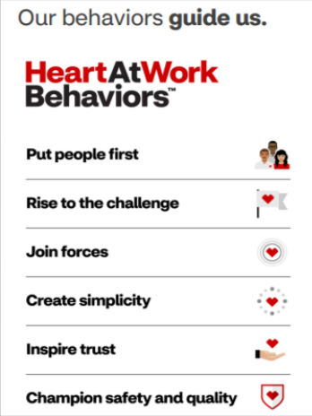
THANK YOU!!
Thank you to each person that is part of the Med D Customer Care team for a successful 2025 Welcome Season!
We appreciate you RISING TO THE CHALLENGE and JOINING FORCES to make this happen!

Slide 29

Acknowledgement of Huddle Completion
Please log into LearningHub and search for code
Med D Monthly Huddle March 2025 Course ID 0000303311
By completing this course In LearningHub you are acknowledging the completion of your monthly huddle

Slide 30
CVS Health logo on white background
Accessibility guidance
A title is included at the top of this slide outside of the frame.

